Slide 1
Computational EM Overview
Steven G. Johnson
MIT course 18.369/8.315
Spring 2020

Slide 2
first, some perspective…

Slide 3
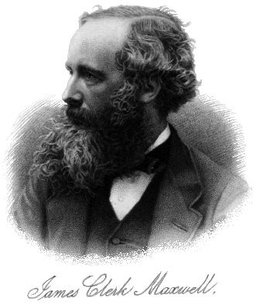
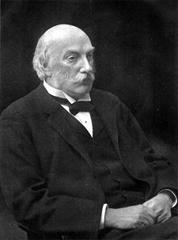
Development of Classical EM Computations
1
Analytical solutions
vacuum, single/double interfaces
various electrostatic problems, …
scattering from small particles,
periodic multilayers (Bragg mirrors), …
… & other problems with
very high symmetry
and/or separability
and/or small parameters
Lord Rayleigh

Slide 4
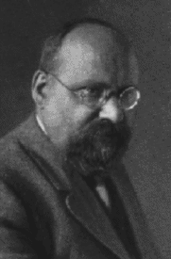
Development of Classical EM Computations
1
Analytical solutions
2
Semi-analytical solutions: series expansions
e.g. Mie scattering of light by a sphere
Also called spectral methods:
Expand solution in rapidly converging Fourier-like basis
• spectral integral-equation methods:
exactly solve homogeneous regions (Green’s func.),
& match boundary conditions via spectral basis
(e.g. Fourier series, spherical harmonics)
• spectral PDE methods:
spectral basis for unknowns in inhomogeous space
(e.g. Fourier series, Chebyshev polynomials, …)
& plug into PDE and solve for coefficients
Gustav Mie
(1908)

Slide 5
Development of Classical EM Computations
1
Analytical solutions
2
Semi-analytical solutions & spectral methods
Expand solution in rapidly converging Fourier-like basis
Strength: can converge exponentially fast
— fast enough for hand calculation
— analytical insights, asymptotics, …
Limitation: fast (“spectral”) convergence requires
basis to be redesigned for each geometry
(to account for any discontinuities/singularities
… complicated for complex geometries!)
(Or: brute-force Fourier series, polynomial convergence)
e.g. Mie scattering of light by a sphere
Gustav Mie
(1908)

Slide 6
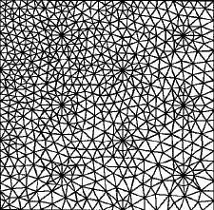
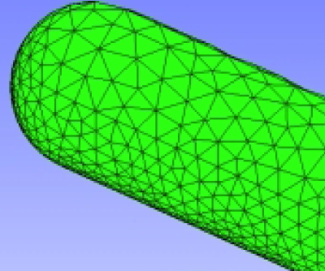
Development of Classical EM Computations
1
Analytical solutions
2
Semi-analytical solutions & spectral methods
3
Brute force: generic grid/mesh (or generic spectral)
PDEs: discretize space into grid/mesh
— simple (low-degree polynomial)
approximations in each pixel/element
integral equations:
— boundary elements mesh
surface unknowns coupled
by Green’s functions
←finite differences
(or Fourier series)
& finite elements→
lose orders of magnitude in performance … but re-usable code
€ computer time << €€€€ programmer time

Slide 7
Computational EM: Three Axes of Comparison
— eigenproblems: harmonic modes ~ e^{–iωt} (J = 0)
— frequency-domain response: E, H from J(x)e^{–iωt}
— time-domain response: E, H from J(x, t)
— PDE or integral equation?
• What problem is solved?
— finite differences (FD)
— finite elements (FEM) / boundary elements (BEM)
— spectral / Fourier
— …
• What discretization?
infinitely many unknowns
⇒ finitely many unknowns
— dense linear solvers (LAPACK)
— sparse-direct methods
— iterative methods
• What solution method?

Slide 8
A few lessons of history
All approaches still in widespread use
brute force methods in 90%+ of papers, typically the first resort to see what happens in a new geometry
geometry-specific spectral methods still popular, especially when particular geometry of special interest
analytical techniques used less to solve new geometries than to prove theorems, treat small perturbations, etc.
No single numerical method has “won” in general
each has strengths and weaknesses, e.g. tradeoff between simplicity/generalizability and performance/scalability
very mature/standardized problems (e.g. capacitance extraction) use increasingly sophisticated methods (e.g. BEM), research fields (e.g. nanophotonics) tend to use simpler methods that are easier to modify (e.g. FDTD)

Slide 9
Computing & Interpreting Band Structures & Dispersion Relations
Steven G. Johnson
MIT Applied Mathematics

Slide 10
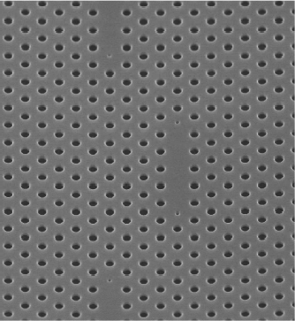
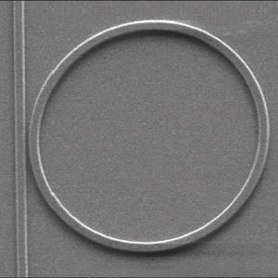
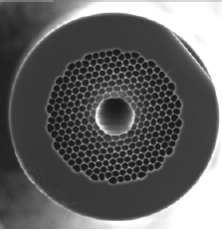
Understanding Photonic Devices
[ Xu & Lipson, 2005 ]
[ Notomi et al. (2005). ]
10µm
20 µm
420 nm
[Mangan, et al.,
OFC 2004 PDP24 ]
Model the whole thing at once? Too hard to understand & design.
Break it up into pieces first: periodic regions, waveguides, cavities

Slide 11
Building Blocks: “Eigenfunctions”
• Want to know what solutions exist in different regions
and how they can interact: look for time-harmonic modes ~ e^{–iωt}
1
First task:
get rid of this mess
0
+ constraint
eigen-operator
(Hermitian for lossless/real ε!)
eigen-value
“eigen-field”

Slide 12
Building Blocks: Periodic Media
homogeneous
media
common thread:
translational
symmetry
waveguides
discrete periodicity: photonic crystals

Slide 13
Periodic Hermitian Eigenproblems
[ G. Floquet, “Sur les équations différentielles linéaries à coefficients périodiques,” Ann. École Norm. Sup. 12, 47–88 (1883). ]
[ F. Bloch, “Über die quantenmechanik der electronen in kristallgittern,” Z. Physik 52, 555–600 (1928). ]
if eigen-operator is periodic, then Bloch-Floquet solutions:
can choose:
planewave
periodic “envelope”
Corollary 1: k is conserved, i.e. no scattering of Bloch wave
Corollary 2: given by finite unit cell,
so ω are discrete ω_{n}(k)

Slide 14
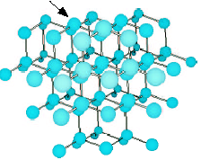
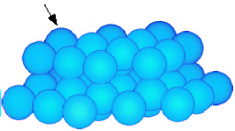
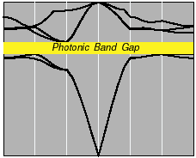
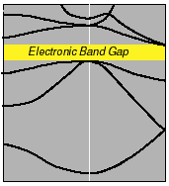
Electronic and Photonic Crystals
atoms in diamond structure
dielectric spheres, diamond lattice
Periodic
Medium
Bloch waves:
Band Diagram
photon frequency
electron energy
wavevector
wavevector
weakly-interacting bosons
… many design degrees of freedom
strongly interacting fermions

Slide 15
Solving the Maxwell Eigenproblem
Finite cell ➔ discrete eigenvalues ω_{n}
Want to solve for ω_{n}(k),
& plot vs. “all” k for “all” n,
constraint:
where field =
H_{n}(x) e^{i(k∙x – ωt)}
1
Limit range of k: irreducible Brillouin zone
2
Limit degrees of freedom: expand H in finite basis
3
Efficiently solve eigenproblem: iterative methods

Slide 16
Solving the Maxwell Eigenproblem: 1
1
Limit range of k: irreducible Brillouin zone
—Bloch’s theorem: solutions are periodic in k
M
k_{y}
first Brillouin zone
= minimum |k| “primitive cell”
Γ
X
k_{x}
irreducible Brillouin zone: reduced by symmetry
2
Limit degrees of freedom: expand H in finite basis
3
Efficiently solve eigenproblem: iterative methods

Slide 17
Solving the Maxwell Eigenproblem: 2a
1
Limit range of k: irreducible Brillouin zone
2
Limit degrees of freedom: expand H in finite basis (N)
solve:
finite matrix problem:
inner product:
Galerkin method:
3
Efficiently solve eigenproblem: iterative methods

Slide 18
Solving the Maxwell Eigenproblem: 2b
1
Limit range of k: irreducible Brillouin zone
2
Limit degrees of freedom: expand H in finite basis
— must satisfy constraint:
Planewave (FFT) basis
Finite-element basis
constraint, boundary conditions:
Nédélec elements
[ Nédélec, Numerische Math.
35, 315 (1980) ]
constraint:
nonuniform mesh,
more arbitrary boundaries,
complex code & mesh, O(N)
uniform “grid,” periodic boundaries,
simple code, O(N log N)
[ figure: Peyrilloux et al.,
J. Lightwave Tech.
21, 536 (2003) ]
3
Efficiently solve eigenproblem: iterative methods

Slide 19
Solving the Maxwell Eigenproblem: 3a
1
Limit range of k: irreducible Brillouin zone
2
Limit degrees of freedom: expand H in finite basis
3
Efficiently solve eigenproblem: iterative methods
Slow way: compute A & B, ask LAPACK for eigenvalues
— requires O(N²) storage, O(N³) time
Faster way:
— start with initial guess eigenvector h₀
— iteratively improve
— O(Np) storage, ~ O(Np²) time for p eigenvectors
(p smallest eigenvalues)

Slide 20
Solving the Maxwell Eigenproblem: 3b
1
Limit range of k: irreducible Brillouin zone
2
Limit degrees of freedom: expand H in finite basis
3
Efficiently solve eigenproblem: iterative methods
Many iterative methods:
— Arnoldi, Lanczos, Davidson, Jacobi-Davidson, …,
Rayleigh-quotient minimization

Slide 21
Solving the Maxwell Eigenproblem: 3c
1
Limit range of k: irreducible Brillouin zone
2
Limit degrees of freedom: expand H in finite basis
3
Efficiently solve eigenproblem: iterative methods
Many iterative methods:
— Arnoldi, Lanczos, Davidson, Jacobi-Davidson, …,
Rayleigh-quotient minimization
for Hermitian matrices, smallest eigenvalue ω₀ minimizes:
variational
/ min–max
theorem
minimize by preconditioned
conjugate-gradient (or…)

Slide 22
Band Diagram of 2d Model System (radius 0.2a rods, ε=12)
a
frequency ω (2πc/a) = a / λ
irreducible Brillouin zone
Γ
X
M
Γ
M
E
gap for
n > ~1.75:1
X
TM
Γ
H

Slide 23
The Iteration Scheme is Important
(minimizing function of 10⁴–10⁸+ variables!)
Steepest-descent: minimize (h + α ∇f) over α … repeat
Conjugate-gradient: minimize (h + α d)
— d is ∇f + (stuff): conjugate to previous search dirs
Preconditioned steepest descent: minimize (h + α d)
— d = (approximate A⁻¹) ∇f ~ Newton’s method
Preconditioned conjugate-gradient: minimize (h + α d)
— d is (approximate A⁻¹) [∇f + (stuff)]

Slide 24
The Iteration Scheme is Important
(minimizing function of ~40,000 variables)
no preconditioning
% error
preconditioned
conjugate-gradient
no conjugate-gradient
# iterations

Slide 25
The Boundary Conditions are Tricky
E|| is continuous
E⊥ is discontinuous
(D⊥ = εE⊥ is continuous)
ε?
Use a tensor ε:
E||
[ Meade et al. (1993) ]
E⊥

Slide 26
The ε-averaging is Important
correct averaging
changes order
of convergence
from ∆x to ∆x²
backwards averaging
% error
no averaging
reason in a nutshell:
averaging
= smoothing ε
= changing structure
… must pick smoothing
with zero 1st-order
perturbation
[ Farjadpour et al. (2006) ]
tensor averaging
resolution (pixels/period)

Slide 27
Closely related to anisotropic metamaterial, e.g. multilayer film in large-λ limit
key to anisotropy is differing
continuity conditions on E:
E|| continuous ⇒ ε|| = <ε>
D⊥=εE⊥ continuous ⇒ ε⊥ = <ε^{–1}>^{–1}
a
λ >> a

Slide 28
Intentional “defects” are good
microcavities
waveguides (“wires”)

Slide 29
Intentional “defects” in 2d
(Same computation, with supercell = many primitive cells)
(boundary conditions ~ irrelevant
for exponentially localized modes)

Slide 30
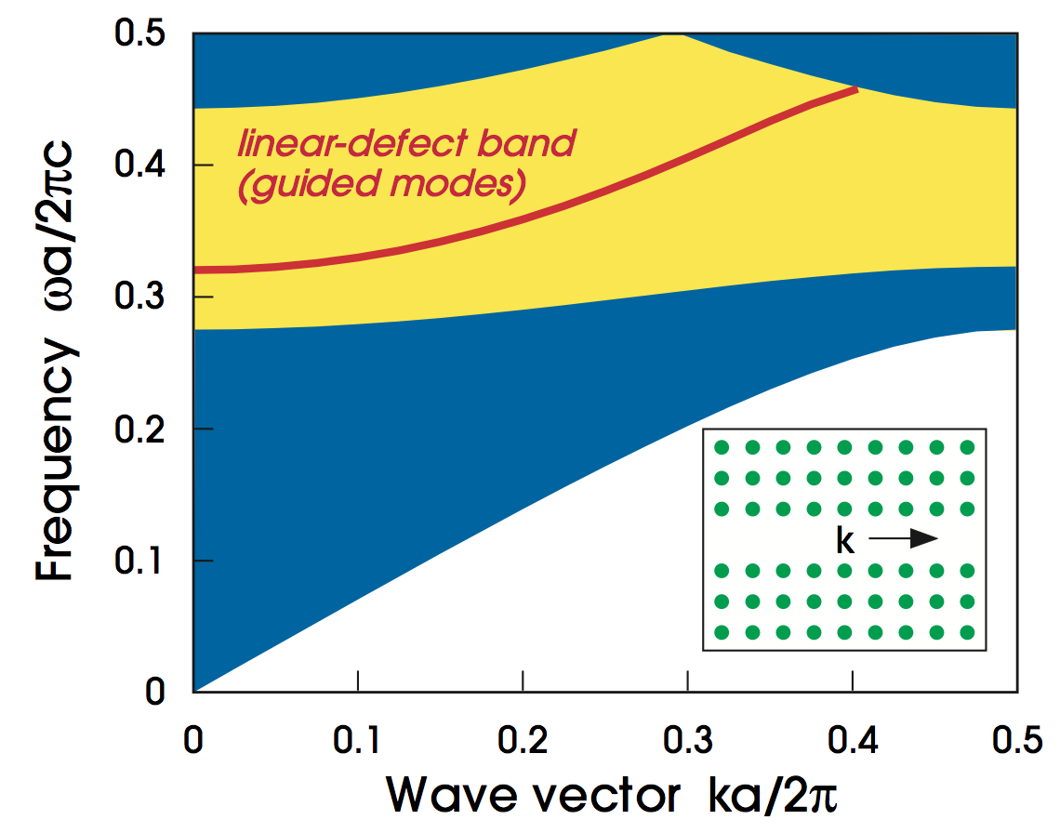
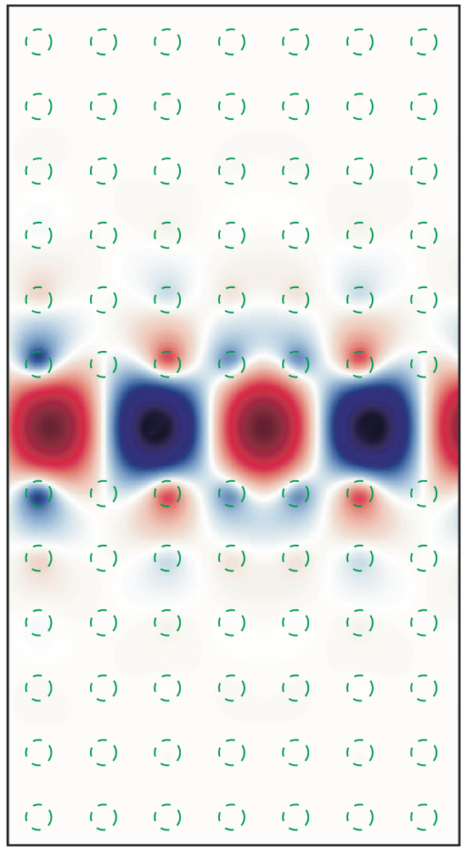
Air-waveguide Band Diagram
projection of bulk-crystal
band diagram
any state in the gap cannot couple to bulk crystal –> localized

Slide 31
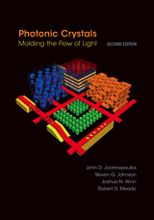
to be continued…
Further reading:
Photonic Crystals book: http://jdj.mit.edu/book
Bloch-mode eigensolver: http://jdj.mit.edu/mpb

Slide 32
Computational Nanophotonics: Cavities and Resonant Devices
Steven G. Johnson
MIT Applied Mathematics

Slide 33
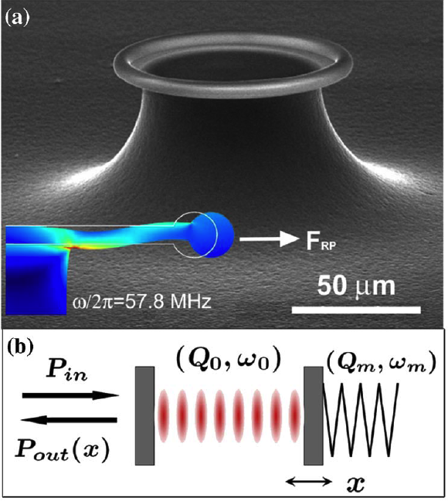
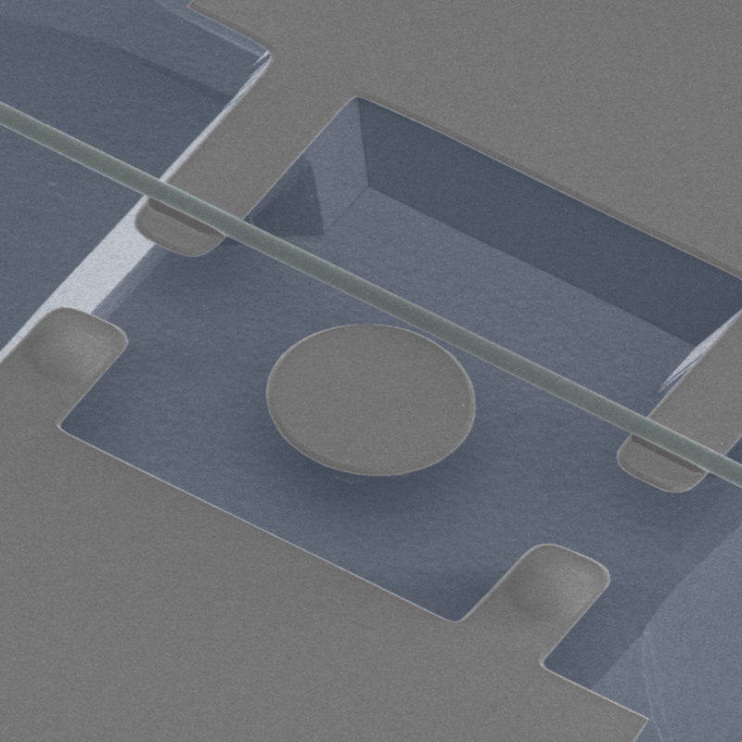
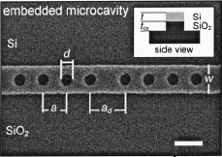
Resonance
an oscillating mode trapped for a long time in some volume
(of light, sound, …)
frequency ω₀
lifetime τ >> 2π/ω₀
quality factor Q = ω₀τ/2
energy in cavity ~ e^{–ω0t/Q}
modal
volume V
[ Notomi et al. (2005). ]
[ C.-W. Wong,
APL 84, 1242 (2004). ]
[ Schliesser et al.,
PRL 97, 243905 (2006) ]
420 nm
[ Eichenfield et al. Nature Photonics 1, 416 (2007) ]

Slide 34
Resonance = Pole in Green’s Function
an oscillating mode trapped for a long time in some volume
(of light, sound, …)
frequency ω₀
lifetime τ >> 2π/ω₀
quality factor Q = ω₀τ/2
energy in cavity ~ e^{–ω0t/Q}
modal
volume V
~ volume where
residue is large
Im ω
near ω₀, Green’s function is dominated by
contribution of the pole ~ a “resonant mode” profile
Re ω
×
simple pole
at ω₀ – i/τ
response to a narrowband pulse
~ exponential decay in time
(in vicinity of the cavity)
[causality/passivity: poles only for Im ω ≤ 0]

Slide 35
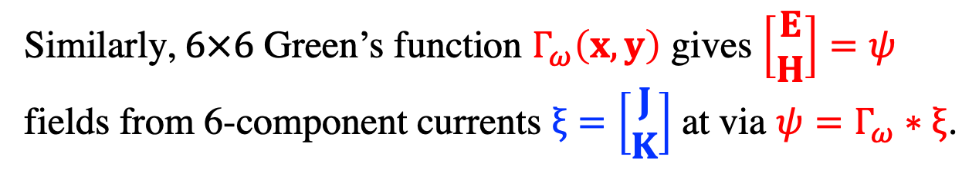
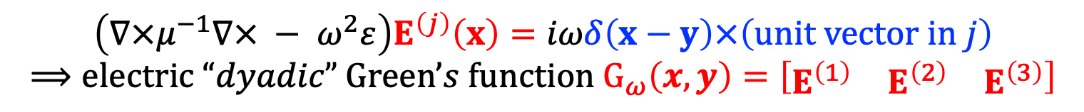
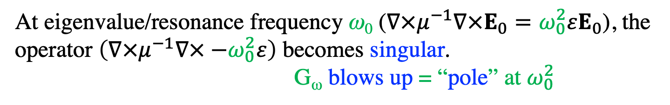
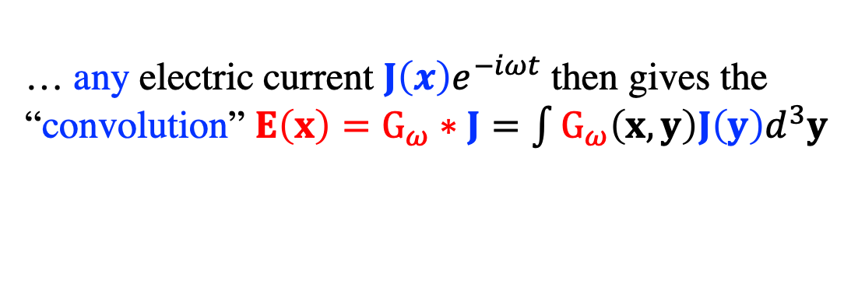
Green’s functions, briefly
Green’s function = field(s) at x from dipole at y
at a frequency ω
$$\left(∇×μ^{−1}∇× − ω^{2}ε\right)E^{\left(j\right)}\left(x\right)=iωδ\left(x−y\right)×\left(\text{unit} \text{vector} \text{in} j\right)$$
$$⟹\text{electric} “dyadic” \text{Green}’s function G_{ω}\left(x,y\right)=\left[\begin{matrix}E^{\left(1\right)} & E^{\left(2\right)} & E^{\left(3\right)}\end{matrix}\right]$$
… any electric current $J\left(x\right)e^{−iωt}$ then gives the “convolution” $E\left(x\right)=G_{ω}∗J=\int{G_{ω}\left(x,y\right)J\left(y\right)d^{3}y}$
At eigenvalue/resonance frequency ω₀ ($∇×μ^{−1}∇×E_{0}=ω_{0}^{2}εE_{0}$), the operator $\left(∇×μ^{−1}∇× −ω_{0}^{2}ε\right)$ becomes singular.
G_{ω} blows up = “pole” at $ω_{0}^{2}$
Similarly, $6×6$ Green’s function $Γ_{ω}\left(x,y\right)$ gives $\left[\begin{matrix}E \\ H\end{matrix}\right]=ψ$ fields from 6-component currents $ξ=\left[\begin{matrix}J \\ K\end{matrix}\right]$ at via $ψ=Γ_{ω}∗ξ$.

Slide 36
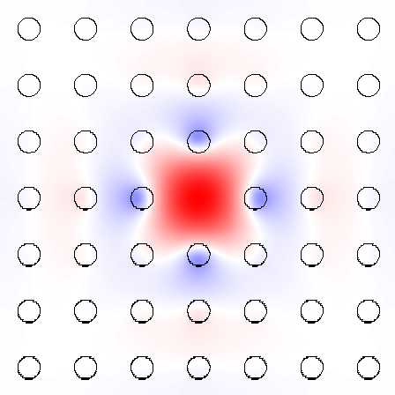
Microcavity Blues
For cavities (point defects)
frequency-domain has its drawbacks:
• Best methods compute lowest-ω eigenvals,
but N^{d} supercells have N^{d} modes
below the cavity mode — expensive
• Best methods are for Hermitian operators,
but losses requires non-Hermitian

Slide 37
Time-Domain Eigensolvers (finite-difference time-domain = FDTD)
Simulate Maxwell’s equations on a discrete grid,
+ absorbing boundaries (leakage loss)
• Excite with broad-spectrum dipole ( ) source
Δω
tricky
signal processing
Response is many
sharp peaks,
one peak per mode
complex ω_{n}
[ Mandelshtam,
J. Chem. Phys. 107, 6756 (1997) ]
decay rate in time gives loss

Slide 38
FDTD: finite difference time domain
Finite-difference-time-domain (FDTD) is a method to model Maxwell’s equations on a discrete time & space grid using finite centered differences
E
H
z
x
K.S. Yee 1966
H
y
E
A. Taflove & S.C. Hagness 2005
y
E
x
H
z

Slide 39
FDTD: Yee leapfrog algorithm
2d example:
at time t: Update D fields everywhere
using spatial derivatives of H, then find E=ε⁻¹D
E_{y}
H_{z}
E_{x} +=
∆t
ε ∆y
( H_{z}^{j+0.5}
– H_{z}^{j-0.5} )
E_{x}
E_{y} -=
∆t
ε ∆x
( H_{z}^{i+0.5}
– H_{z}^{i-0.5} )
2) at time t+0.5: Update H fields everywhere using spatial derivatives of E
E_{y}
H_{z}
H_{z} +=
∆t
μ
( E_{x}^{j+1}
– E_{x}^{j}
+ E_{y}^{i}
– E_{y}^{i+1})
∆y
∆x
E_{x}
CFL/Von Neumann stability: cΔt < 1 / √Δx^{–2}+Δy^{–2}

Slide 40
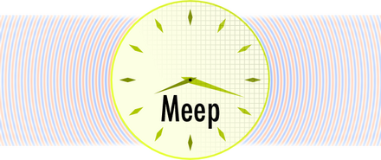
Free software: MEEP
http://ab-initio.mit.edu/meep
• FDTD Maxwell solver: 1d/2d/3d/cylindrical
• Parallel, scriptable, integrated optimization, signal processing
• Arbitrary geometries, anisotropy, dispersion, nonlinearity
• Bloch-periodic boundaries, symmetry boundary conditions,
+ PML absorbing boundary layers…

Slide 41
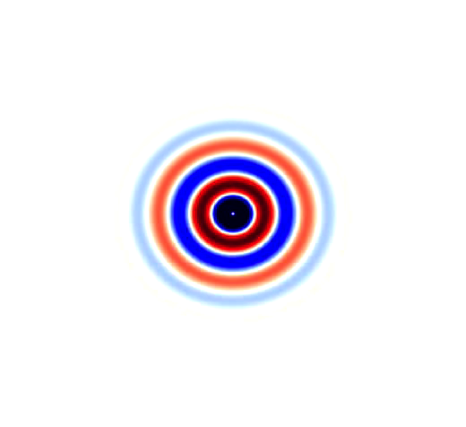
Absorbing boundaries?
Finite-difference/finite-element volume discretizations
need to artificially truncate space for a computer simulation.
In a wave equation,
a hard-wall truncation
gives reflection artifacts.
An old goal: “absorbing boundary condition” (ABC) that absorbs outgoing waves.
Problem: good ABCs are hard to find in > 1d.

Slide 42
Perfectly Matched Layers (PMLs)
Bérenger, 1994: design an artificial absorbing layer
that is analytically reflectionless
Works remarkably well.
Now ubiquitous in FD/FEM
wave-equation solvers.
Several derivations, cleanest
& most general via “complex
coordinate stretching”
[ Chew & Weedon (1994) ]

Slide 43
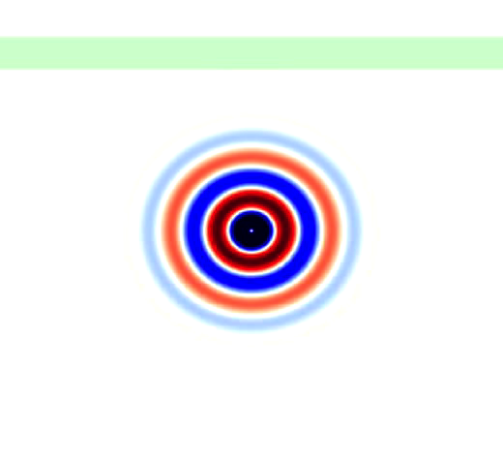
Perfectly Matched Layers (PMLs)
Bérenger, 1994: design an artificial absorbing layer
that is analytically reflectionless
Even works in inhomogeneous
media (e.g. waveguides).

Slide 44
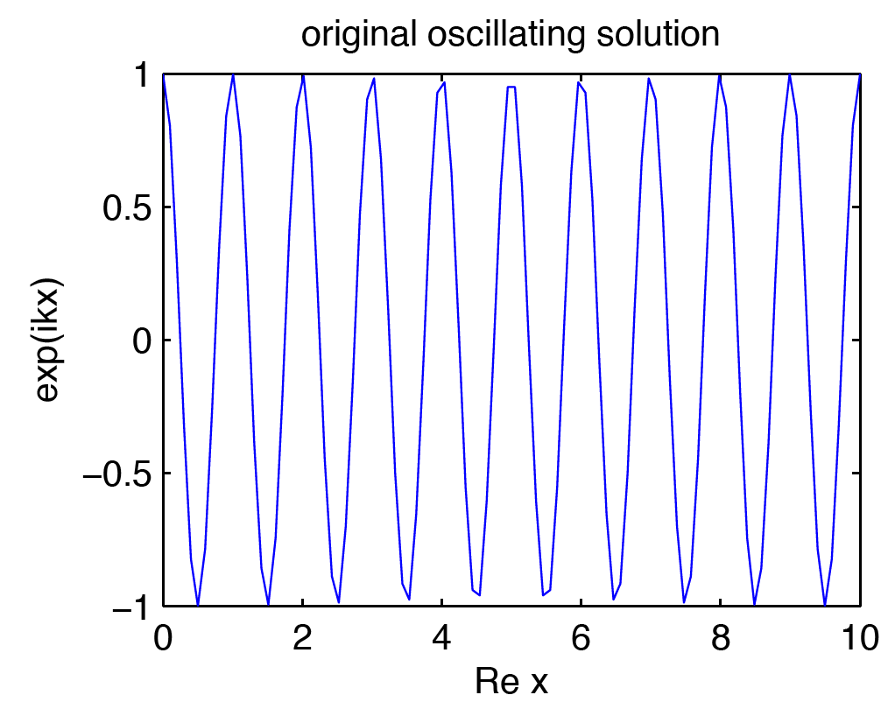
PML Starting point: propagating wave
• Say we want to absorb wave traveling in +x direction
in an x-invariant medium at a frequency ω > 0.
(usually, k > 0)
[ rare “backward-wave”
cases defeat PML
(Loh, 2009) ]
(only x in wave
equation is via
terms.)

Slide 45
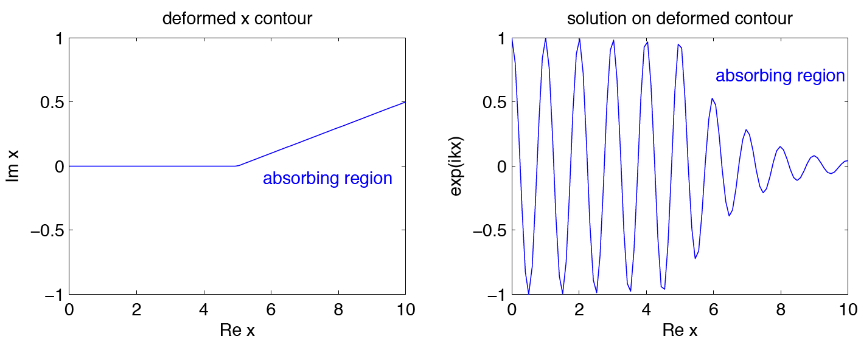
PML step 1: Analytically continue
Electromagnetic fields & equations are analytic in x,
so we can evaluate at complex x & still solve same equations
unchanged
(no reflection)
unchanged
(no reflection)

Slide 46
PML step 2: Coordinate transformation
~
Weird to solve equations for complex coordinates x,
so do coordinate transformation back to real x.
1
2
(allow x-dependent
PML strength σ)
nondispersive materials: k/ω ~ constant
so decay rate independent of ω
(at a given incidence angle)

Slide 47
PML Step 3: Effective materials
In Maxwell’s equations,
coordinate transformations are equivalent to transformed materials
(Ward & Pendry, 1996: “transformational optics”)
x PML Jacobian
for isotropic starting materials:
effective
conductivity
PML = effective anisotropic “absorbing” ε, μ

Slide 48
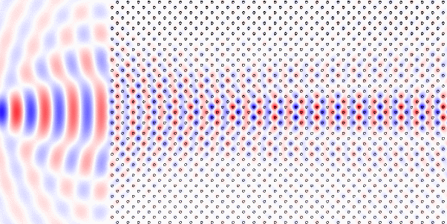
Photonic-crystal PML?
FDTD (Meep) simulation:
?
?
?
?
?
ε not even continuous
in x direction,
much less analytic!
x
Analytic continuation of Maxwell’s equations is hopeless
— no reason to think that PML technique should work

Slide 49
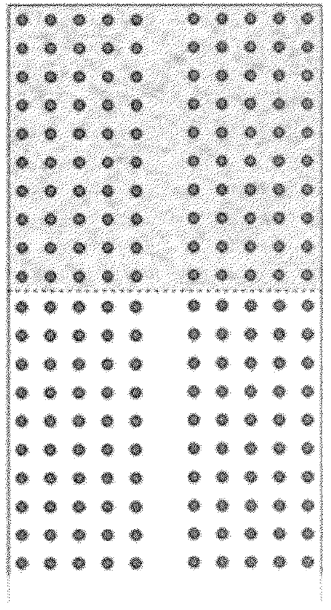
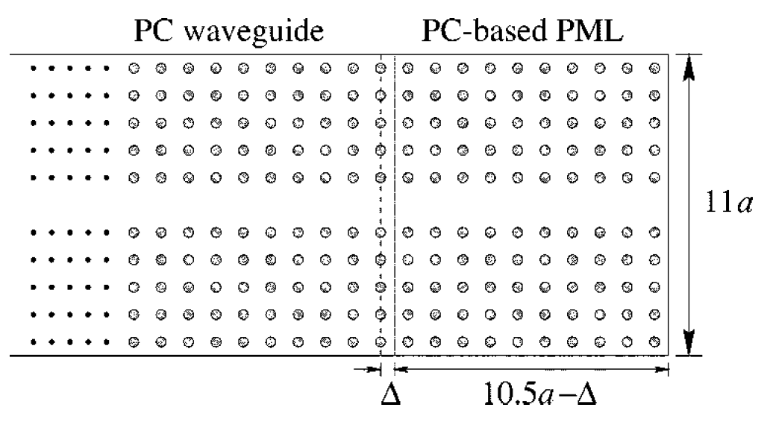
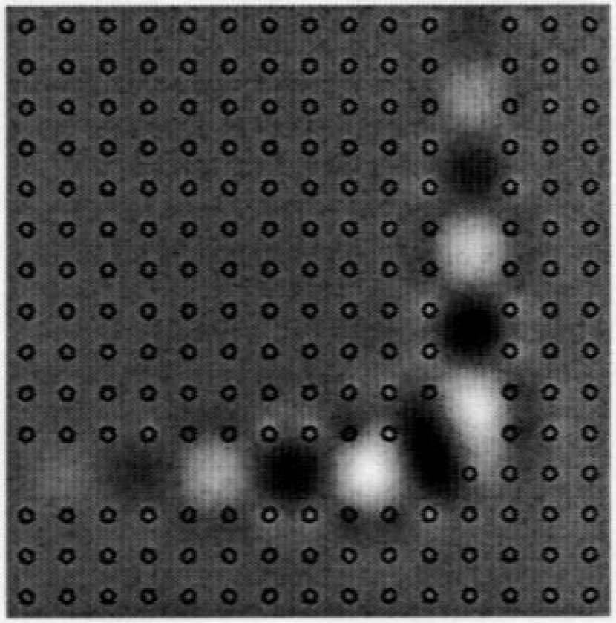
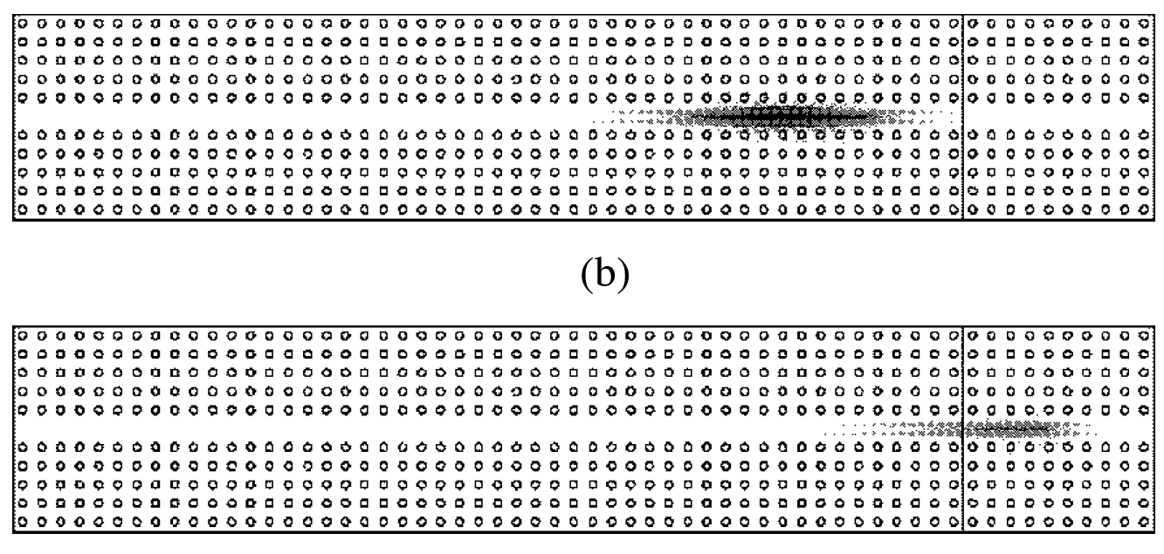
Photonic-crystal PMLs: Magic?
[ Kosmidou et al (2003) ]
[ Koshiba, Tsuji, & Sasaki (2001) ]
PML
… & several other authors …
Low reflections claimed
— is PML working?
Something suspicious:
very thick absorbers.

Slide 50
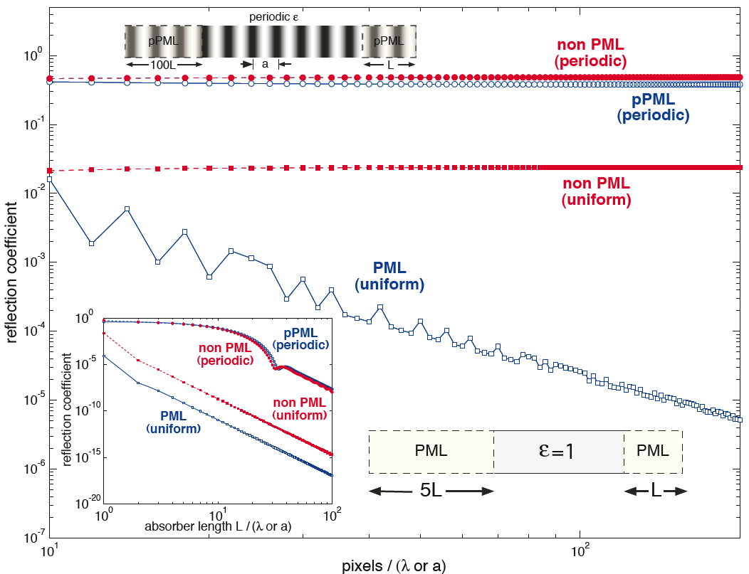
Failure of Photonic-crystal “pseudo-PML”
[ Oskooi et al, Optics Express 16, 11376 (2008) ]
1d test case:
(pseudo-)
PML in
periodic ε
reflection
doesn’t → 0
as ∆x → 0
… similar
to non-PML
scalar σ
in uniform ε=1 medium,
PML reflection → 0
for exact wave equation

Slide 51
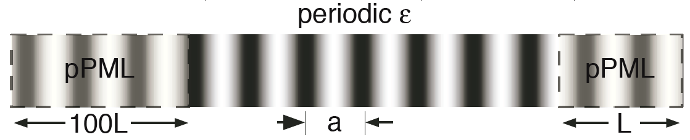
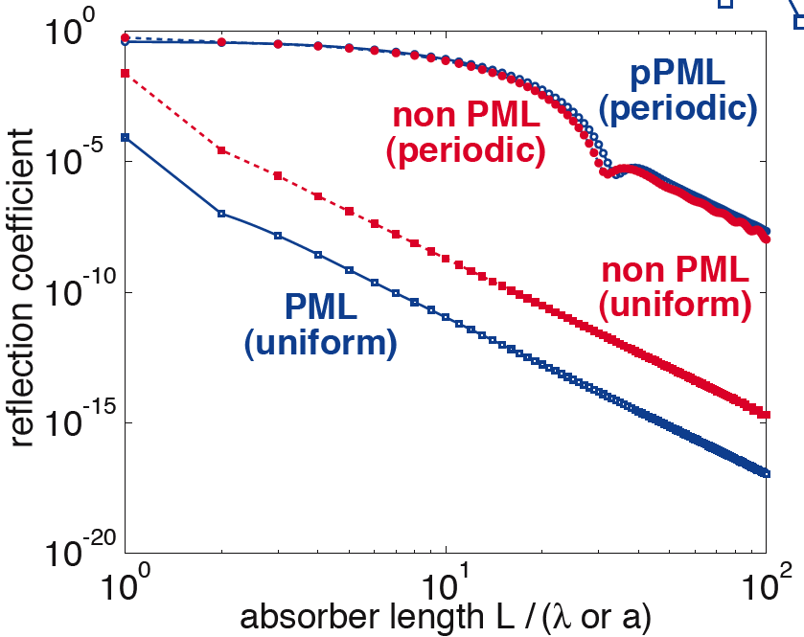
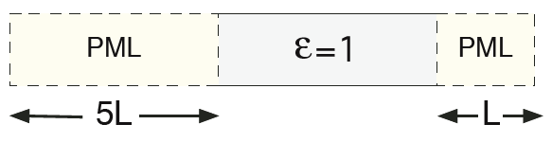
Redemption of the pseudo-PML: slow (“adiabatic”) absorption turn-on
[ Oskooi et al, Optics Express 16, 11376 (2008) ]
Any absorber,
turned on gradually
enough, will have
reflections → 0!
PML (when it works)
just helps coefficient.

Slide 52
What about DtN / RCWA / Bloch-mode-expansion / SIE methods?
— useful, nice methods that can impose outgoing boundary conditions
exactly, once the Green’s function / Bloch modes computed
challenge problem for any method:
periodic 3d dielectric waveguide bend in air
(note: both guided and radiating modes!)
… DtN / Green’s function / Bloch modes (incl. radiation!) expensive

Slide 53
Computational Nanophotonics: Sources & Integral Equations
Steven G. Johnson
MIT Applied Mathematics

Slide 54
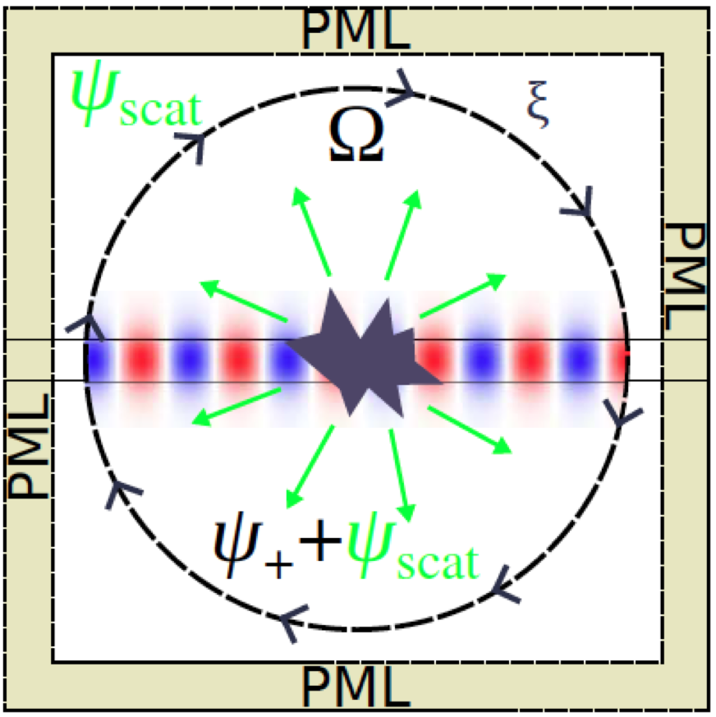
How can we excite a desired incident wave?
Want some current source
to excite incident waveguide
mode, planewave, etc…
— also called transparent
source since waves
do not scatter from it
(thanks to linearity)
— vs. hard source =
Dirichlet field condition
?
?

Slide 55
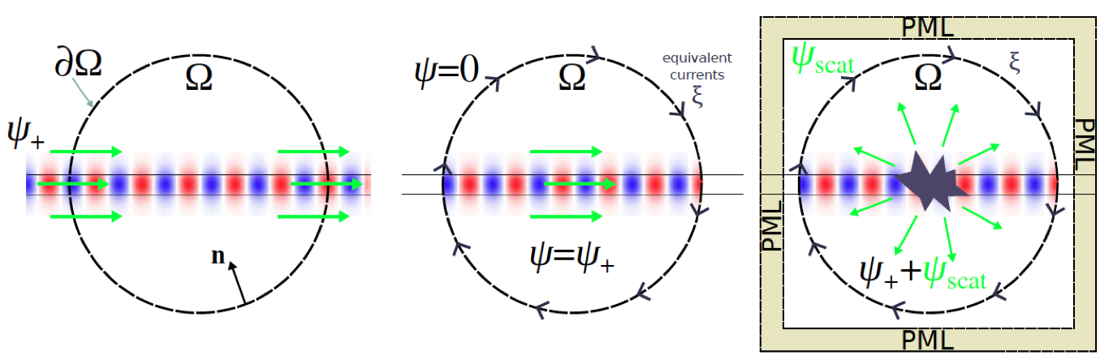
Equivalent currents (“total-field/scattered-field” approach)
[ review article: arXiv:1301.5366 ]
equivalent
currents
c
f⁺
f⁺
f⁺+f–
f–
f=0
known incident fields
in ambient medium
(possibly inhomogeneous,
e.g. waveguide or photonic crystal)
want to construct
surface currents
do simulations
in finite domain
+ inhomogeneities
/ interactions
= scattered field f–
giving same f⁺ in Ω

Slide 56
The Principle of Equivalence in classical EM (or Stratton–Chu equivalence principle) (formalizes Huygens’ Principle) (or total-field/scattered-field, TFSF) (close connection to Schur complement [Kuchment])
[ see e.g. Harrington, Time-Harmonic Electromagnetic Fields ]
[ review article: arXiv:1301.5366 ]

Slide 57
starting point: solution in all space
incident
fields f⁺
medium χ
Ω
6-component
fields:
solve (source-free) Maxwell PDE (in frequency domain):

Slide 58
constructing solution in Ω
equivalent
“6”-component
surface currents
c
Ω
f = 0
f = f⁺
n
construct c so that f is a new solution:
c

Slide 59
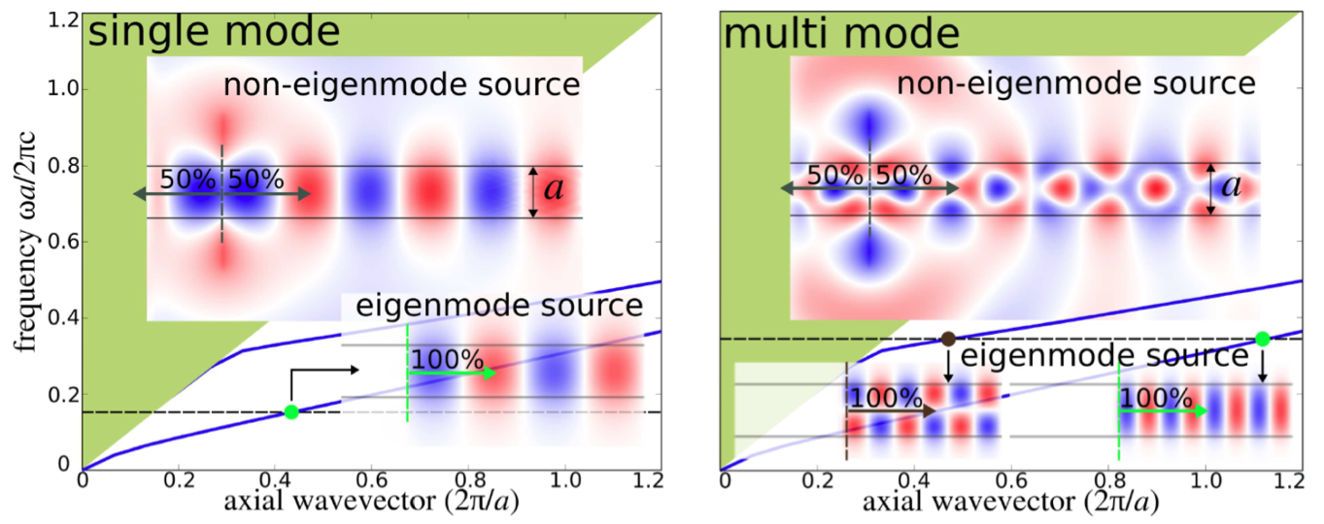
Exciting a waveguide mode in FDTD
— compute mode in MPB, then use as source in MEEP
(constant J)
[ review article: arXiv:1301.5366 ]

Slide 60
Problems with equivalent sources
(if not solved, undesired excitation of other waves)
[ review article: arXiv:1301.5366 ]
• Discretization mismatch: at finite resolution, solutions from
one technique (MPB) don’t exactly match discrete modes
in another technique (Meep) — leads to small imperfections
— solvable by using the same discretization to find modes
• Dispersion: mode profile varies with ω, so injecting a pulse p(t)
requires a convolution with c(x,ω) ↔ c(x,t)
ˆ
Fourier
ˆ
currents(x,t) = p(t) * c(x,t) ≈ p(t) c(x,ω)
time domain only
narrow-bandwidth
– convolutions expensive, can be approximated by
finite-time (FIR/IIR) calculations using DSP techniques
– specialized methods are known for planewave sources
(have numerical dispersion!)

Slide 61
Shortcut: Subtract two simulations
example: 90° bend of single-mode dielectric waveguide
1
1
2
simple
constant-amplitude
line-current J
same J
want incident, transmitted,
and reflected energy-flux spectra:
incident: Poynting flux of f_{straight}
transmitted: flux of f_{bend}
reflected: flux of f_{bend}–f_{straight}
ˆ
2
2
accumulate (discrete-time)
Fourier transforms of fields:
ˆ
2
ˆ
ˆ
1
1
at desired frequencies ω

Slide 62
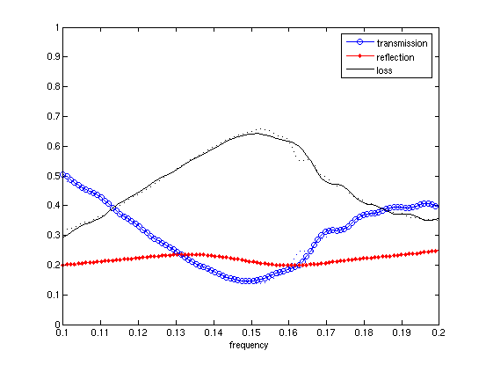


Shortcut: Subtract two simulations
example: 90° bend of single-mode dielectric waveguide
(waveguide width) / λ

Slide 63
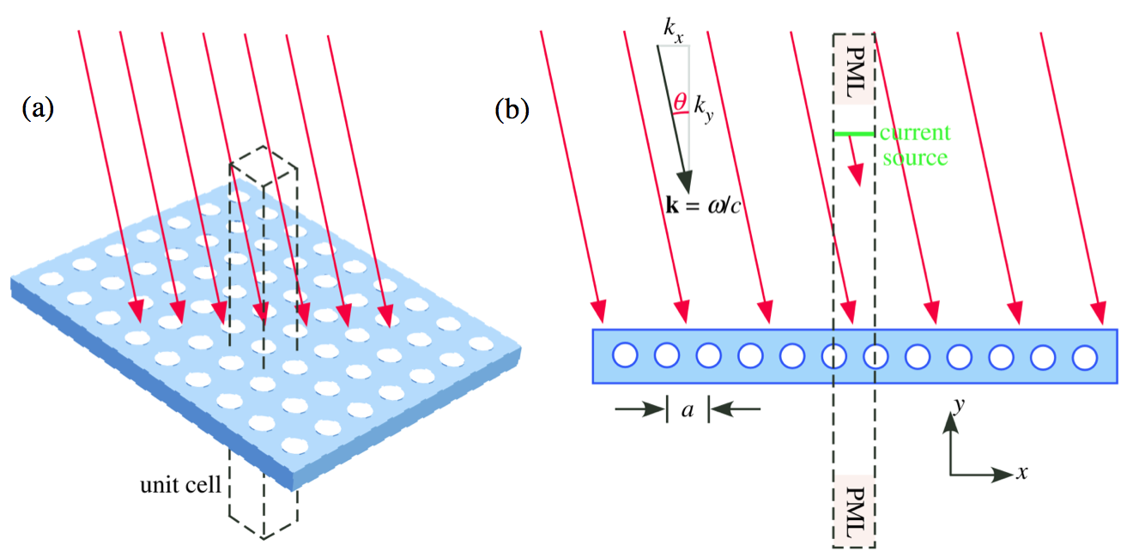
Shortcut: Planewave sources for periodic media
[ review article:
arXiv:1301.5366 ]
Bloch-periodic e^{ikxa}
trick #1: incident & scattered fields
are Bloch-periodic/quasiperiodic
trick #2: e^{ikxx} current source
produces planewave

Slide 64
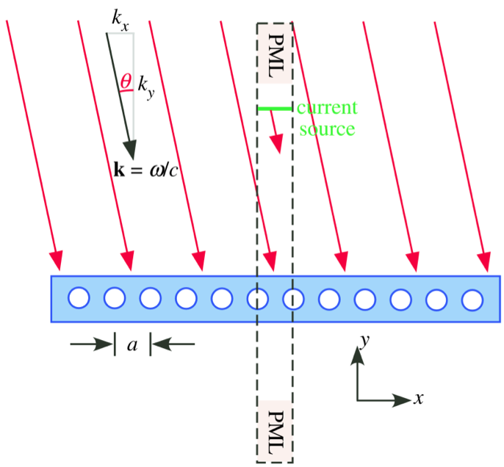
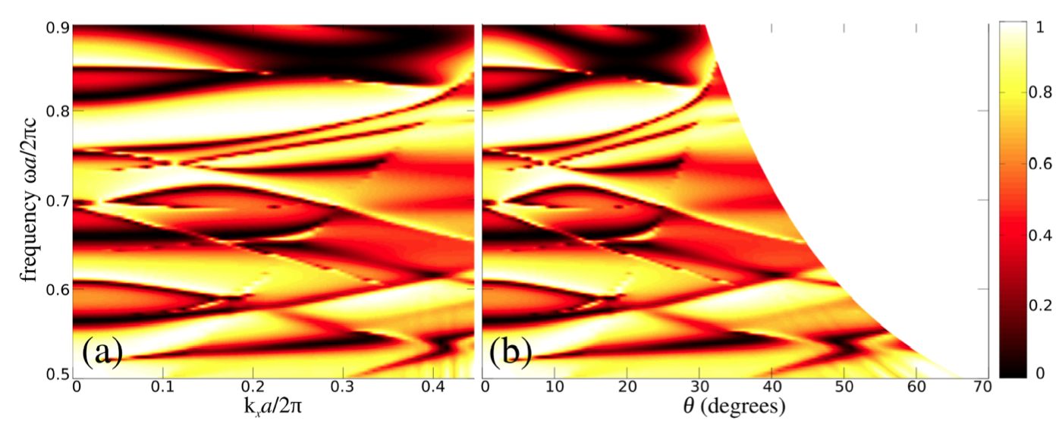
Reflection spectra example for periodic media
(Fano resonance lineshapes)
note: ω all above
light line
(req. for incident planewave)
entire spectrum at fixed k_{x}
from single FDTD simulation
(Fourier transform of pulse)
⟺ curved line
θ = asec(ck_{x}/ω)
in (ω,θ) plot

Slide 65
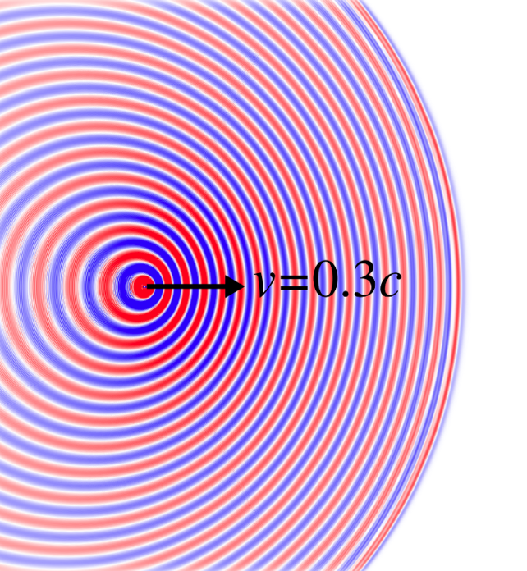
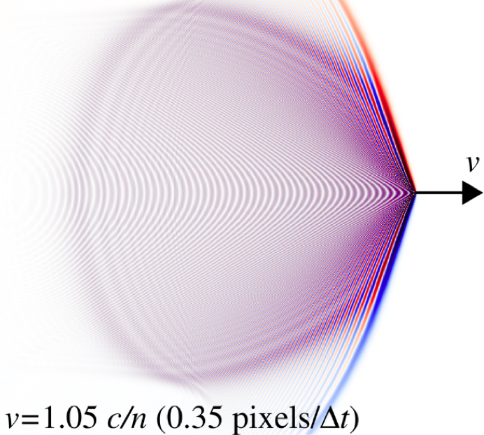
Fun possibilities in FDTD: moving sources [= just some currents J(x,t) ]
Doppler shift from
moving oscillating dipole
Cerenkov radiation from moving
point charge in dielectric medium

Slide 66
Cerenkov radiation
charge density
⇒ current density
x
q
= e^{i(kx–ωt)}
if ω(k)=kv
excites radiating mode ω(k_{x},k_{y})
if v = ω(k_{x},k_{y})/k_{x}
= phase velocity in x direction
≥ c/n in index-n medium

Slide 67
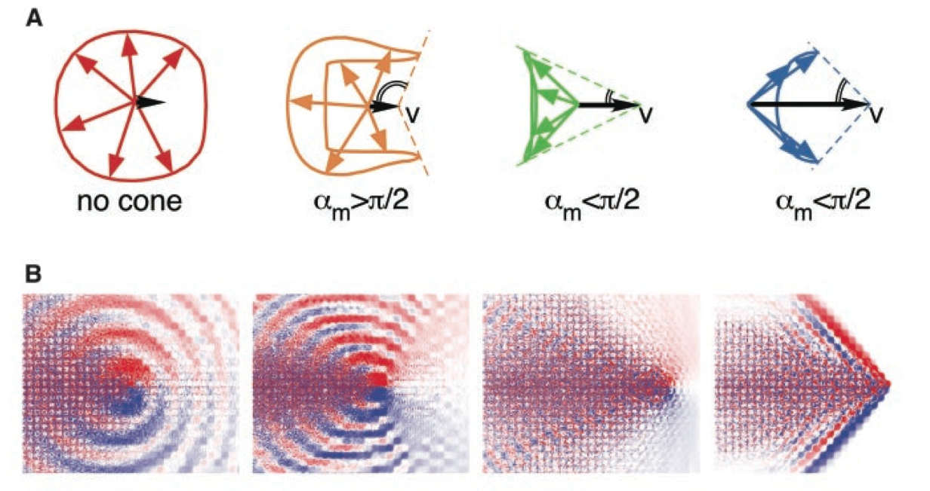
Cerenkov radiation in photonic crystal
excites radiating mode ω(k_{x},k_{y})
if v = ω(k_{x},k_{y})/(k_{x} + 2πm/a)
for any integer m
⇒ no minimum v
[ Smith–Purcell effect ]
v
q
very different radiation
patterns & directions
depending on v,
due to interactions with
2d PhC dispersion curves
[ Luo, Ibanescu, Johnson,
& Joannopoulos (Science, 2002) ]

Slide 68
Surface-integral equations (SIEs) and boundary-element methods (BEMs)
[ see e.g. Harrington, Time-Harmonic Electromagnetic Fields ]
Harrington, “Boundary integral formulations for homogeneous
material bodies,” J. Electromagnetic Waves Appl. 3, 1–15 (1989)
Chew et al., Fast and Efficient Algorithms
in Computational Electromagnetics (2001) ].

Slide 69
Exploiting partial knowledge of Green’s functions
a typical scattering problem:
incident
fields
medium 0
medium 1
scattered
fields
interior
fields
suppose that we know Green’s functions
in infinite medium 0 or medium 1
— known analytically for homogeneous media
— computable by much smaller calculation in periodic medium
Can exploit this to derive integral equation for surface unknowns only.

Slide 70
The Principle of Equivalence in classical EM
[ see e.g. Harrington, Time-Harmonic Electromagnetic Fields ]
incident
fields f⁰⁺
medium 0
medium 1
scattered
fields f^{0–}
interior
fields f¹
6-component
fields:
Maxwell PDE:
… we want to partition
into separate medium 0/1
problems & enforce continuity…

Slide 71
Constructing a medium-0 solution
“equivalent”
6-component
surface currents
c
same incident
fields f⁰⁺
medium 0
medium 0
same
fields f^{0–}
f=0 (!!)
n
modified Maxwell PDE:
c

Slide 72
The Principle of Equivalence I
“equivalent”
6-component
surface currents
c
incident
fields f⁰⁺
medium 0
medium 0
same
scattered
fields f^{0–} of c
f=0 (!!)
convolution with
6x6 Green’s function Γ⁰
of homogenous medium 0
[ e.g. Harrington, Time-Harmonic Electromagnetic Fields ]

Slide 73
The Principle of Equivalence II
opposite-sign
6-component
surface currents
– c
medium 1
f=0
medium 1
convolution with
6x6 Green’s function Γ¹
of homogenous medium 1
[ e.g. Harrington, Time-Harmonic Electromagnetic Fields ]

Slide 74
Surface-Integral Equations (SIE)
unknown
c
medium 0
medium 1
c determined by
continuity of tangential fields
at 0/1 interface:
[ e.g. Harrington, Time-Harmonic Electromagnetic Fields ]

Slide 75
Discretizing the Maxwell SIE
unknown
c
pick some basis b_{n} (n=1,…,N→∞)
for surface-tangential vector fields
N discrete
unknowns x_{n}
⇒ N equations
[ e.g. Harrington, Time-Harmonic Electromagnetic Fields ]

Slide 76
Discretizing the Maxwell SIE
Galerkin method — require error ⊥ basis:
unknown
c
pick some basis b_{n} (n=1,…,N→∞)
for surface-tangential vector fields
N discrete
unknowns x_{n}
⇒ N equations Mx = s
[ e.g. Harrington, Time-Harmonic Electromagnetic Fields ]

Slide 77
Discretized SIE: Two Objects
medium 2
medium 0
medium 1
⇒ linear equations Mx = s
… + straightforward generalizations to more objects,
nested objects, etcetera

Slide 78
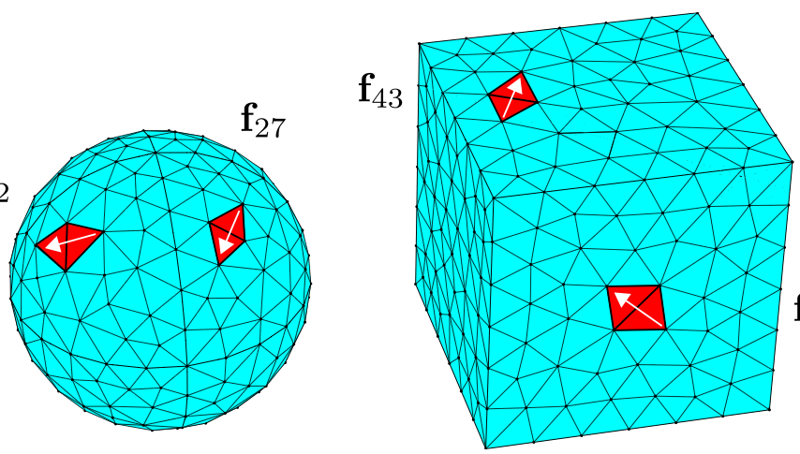
SIE basis choices
• Can use any basis for c = any basis of surface functions
… basis is not incoming/outgoing waves
& need not satisfy any wave equation
• Spectral bases: spherical harmonics, Fourier series, …
… nice for high symmetry
~ uniform spatial resolution
• Boundary Element Methods (BEM):
localized basis functions defined on irregular mesh
“RWG” basis (1982):
vector-valued b_{n} defined
on pairs of adjacent triangles
via degree-1 polynomials

Slide 79
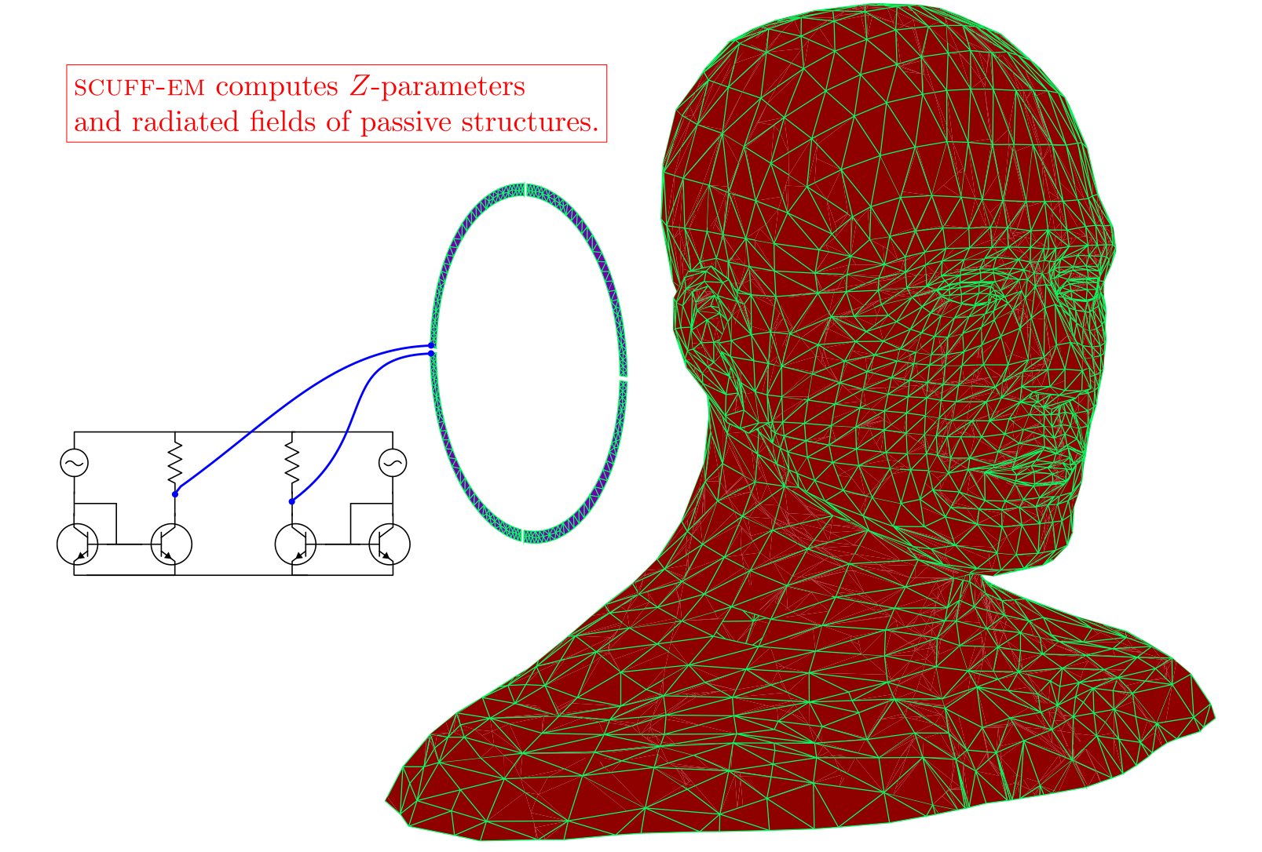
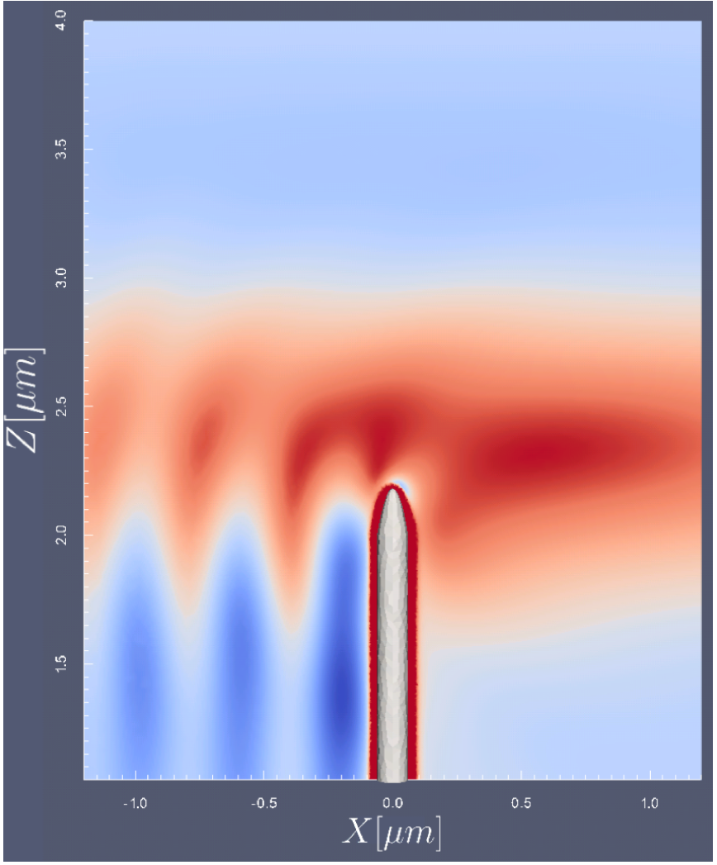

BEM strengths
especially small surface areas in a large (many-λ) volume, e.g.:
complex impedance
of passive structures
surface plasmons (metals):
extremely sub-λ fields
Graphene
~ delta-function
surface conductivity
= jump discontinuity
(~ E) in H field
silver
nanotip
[ Johannes Feist, Harvard ]
[ Llatser et al. (2012) ]

Slide 80
The bad news of BEM
• Not well-suited for nonlinear, time-varying, or
non-piecewise-constant media
• BEM system matrix
— singular integrals for overlapping b_{m}, b_{n}
…special numerical integration techniques
— M is not sparse, but:
often small enough for dense solvers (≲ 10⁴×10⁴)
+ “fast solvers:” approximate sparse factorizations
(fast multipole method, etc.)
— lots of work every time you change Γ
(e.g. 3d vs. 2d, periodic boundaries, anisotropic, …)
… but independent of geometry

Slide 81


The good news of BEM: You don’t have to write it yourself
Free software developed by Dr. Homer Reid
(collaboration with Prof. Jacob White @ MIT)
SCUFF-EM
[ http://homerreid.ath.cx/scuff-EM ]

Slide 82

http://homerreid.com/scuff-EM
* to be released by end of October-ish

Slide 83

SCUFF usage outline

Slide 84

Geometries in SCUFF

Slide 85

Geometries in SCUFF
(discretization of SIE at junctions of 3+ materials is a bit tricky)

Slide 86

Periodic geometries in SCUFF
(implementing periodicity is nontrivial: changes Green’s function!
SCUFF: periodic Γ = Σ(nearest neighbors) + Ewald summation)

Slide 87
Using SIE/BEM solutions
Solving the SIE gives the surface currents c, and
from these (via Γ*c) one can obtain any desired fields, but…
It is much more efficient to compute as much as possible
directly from c (~ n × surface fields). Examples:
• Scattering matrices (e.g. spherical-harmonic waves in → out):
obtain directly from multipole moments of “currents”
• Any bilinear function of the surface fields can be computed
directly from bilinear functions of c:
— scattered/absorbed power, force, torque, …
• Net effects of quantum/thermal fluctuations in matter can
be computed from norm/det/trace of M or M^{–1}:
— thermal radiation, Casimir (van der Waals) forces, …

Slide 88
Resonant modes (and eigenvalues)
• BEM scattering problems are of the form M(ω)x = s.
Resonances (and eigenvalues) are ω where this system
is singular, i.e. the nonlinear eigenproblem
det M(ω) = 0
For passive (⇒causal) systems, solutions can only occur
for Im ω ≤ 0.
• Various algorithms exist, including an intriguing algorithm
using contour integrals of M(ω) [ Beyn (2012) ].

Slide 89
to be continued…
Further reading:
Free FDTD software: http://jdj.mit.edu/meep
Free BEM software:
http://homerreid.ath.cx/scuff-EM/
Review on wave sources:
arXiv:1301.5366 [ in Taflove, Oskooi, & Johnson, eds.,
Advances in FDTD Comput. EM (2013) ]

Slide 90
Computational Nanophotonics: Optimization and “Inverse Design”
Steven G. Johnson
MIT Applied Mathematics

Slide 91
Many, many papers that parameterize by a few degrees of freedom and optimize… Today, focus is on large-scale optimization, also called inverse design: so many degrees of freedom (10²–10⁶) that computer is “discovering” new designs.

Slide 92
Outline
• Brief overview/examples of
large-scale optimization work in photonics
• Overview of optimization terminology,
problem types, and techniques.
• Some more detailed photonics examples.

Slide 93
Outline
• Brief overview/examples of
large-scale optimization work in photonics
• Overview of optimization terminology,
problem types, and techniques.
• Some more detailed photonics examples.

Slide 94









Optical design = optimization
traditional approach: intuition + “tweaking” few parameters
[Noda et. al. 2003]
[Brongersma et. al. 2010]
[Yu et. al. 2010]
[Zhou et. al. 2010]
“black-box” optimization (typically << 100 params)
gradient-based (“adjoint”) optimization (>10⁵ params, 3D)
[Sigmund et. al. Las. Phot. Rev. 5, 308 (2011)]
[X. Liang & SG Johnson Opt. Exp. 21, 30812 (2013)]
[Villegas et. al. 2004]
[Hakansson et. al. 2005]
Notes:
Pen-and-paper = symmetry, periodicity, etc.
Gradient-based: first applied to aerodynamic applications
Discuss a little about the “magic” of topology optimization: twiddling here and there would seem to take 1000’s of extra simulations, but it only takes one! I won’t get into it here, but there’s a very nice understanding about how each piece of information occupies one “voxel” in the second simulation, such that the second simulation as a whole contains the derivative of each voxel.

Slide 95





Large-scale optimization in photonics: “Every pixel” is a degree of freedom
solar-cell backreflector optimization
bend optimization
Ganapati et al. IEEE Jour. of Photovolt. 4, 175 (2014)
2d band gaps
Sigmund et al.,
Opt. Express 12, 1996 (2004)
OE 12, 5916 (2004)
Dobson (1999)

Slide 96

Topology optimization
A
Given two (or more) materials
A and B, determine what arrangement
— including what topology —
optimizes some objective/constraints.
Electromagnetism:
Materials (mostly) described by
permittivity (dielectric constant) ε
(susceptibility χ=ε–1)
B
B

Slide 97
Discretizing Topology Optimization
for computer, need finite-dimensional, differentiable parameters
some computational grid
Level-set method: value of
“level-set” function φ(x) varies
continuously at each pixel
⇒ material A or B if φ > 0 or < 0
… or …
Continuous relaxation: material
varies in [A,B] at each pixel
e.g. in electromagnetism, let ε at each
pixel vary in [A,B].
(+ filtering methods to constrain minimum feature sizes and “binary-ize” result)

Slide 98
Outline
• Brief overview/examples of
large-scale optimization work in photonics
• Overview of optimization terminology,
problem types, and techniques.
• Some more detailed photonics examples.

Slide 99
A general optimization problem
minimize an objective function f₀
with respect to n design parameters x
(also called decision parameters, optimization variables, etc.)
— note that maximizing g(x)
corresponds to f₀ (x) = –g(x)
subject to m constraints
note that an equality constraint
h(x) = 0
yields two inequality constraints
f_{i}(x) = h(x) and f_{i+1}(x) = –h(x)
(although, in practical algorithms, equality constraints typically require special handling)
x is a feasible point if it
satisfies all the constraints
feasible region = set of all feasible x

Slide 100
Important considerations
photonics: mostly
local optima in
non-convex problems
Global versus local optimization
Convex vs. non-convex optimization
Unconstrained or box-constrained optimization, and other special-case constraints
Special classes of functions (linear, etc.)
Differentiable vs. non-differentiable functions
Gradient-based vs. derivative-free algorithms
…
Zillions of different algorithms, usually restricted to various special cases, each with strengths/weaknesses

Slide 101
Relaxations of Integer Programming
If x is integer-valued rather than real-valued (e.g. x ∈ {0,1}^{n}),
the resulting integer programming or combinatorial optimization
problem becomes much harder in general (often NP-complete).
However, useful results can often be obtained by a continuous
relaxation of the problem — e.g., going from x ∈ {0,1}^{n} to x ∈ [0,1]^{n}
… at the very least, this gives an lower bound on the optimum f₀
… and penalty methods (e.g. SIMP) can be used to gradually
eliminate intermediate x values.
Leads to “density based” topology optimization, many methods to impose feature-size constraints etc.

Slide 102
Derivatives are essential
For n ≥ 1000’s of parameters,
impractical unless you have
computed “analytically”
(not by finite differences).
subject to m constraints
minimize an objective function f₀
with respect to n design parameters x
(also called decision parameters, optimization variables, etc.)

Slide 103
Impossible to explore/optimize a 10⁶-dimensional parameter space without derivatives. (Gradient tells you which direction to go for improvement.) (Only local optimization with this many parameters, but can still find very good designs, sometimes with provable guarantees.)

Slide 104
Amazing fact of adjoint methods: all 10⁶ derivatives with two simulations
physical intuition: Born approximation + reciprocity
incident
wave
scattered field
scattered field
+ perturbation ΔE
= field of
J = Δε E₀
field E₀
“forward” solve
perturbed pixel Δε,
expensive: repeat for each pixel?

Slide 105
Amazing fact of adjoint methods: all 10⁶ derivatives with two simulations
physical intuition: Born approximation + reciprocity
scattered field
+ perturbation ΔE
= field of
J = Δε E₀
source at scattered
measurement point
=
(reciprocity)
perturbed pixel Δε,
repeat for each pixel?
solve one adjoint problem
… get fields at all perturbed pixels

Slide 106
Adjoint methods, in math cost of ∇f ~ one extra f(x) evaluation [ google “adjoint method” for reviews ]
toy example: maximizing transmitted power from a source
Maxwell’s equations discretized as:
[ real variables, e = real/imag parts ]
Quadratic objective:
[Q assumed symmetric]
EM
fields
source
Maxwell matrix
(parameters x)
adjoint problem:
= one extra solve with
transposed (adjoint) M

Slide 107
(Don’t let the reciprocity intuition fool you.) There is a general prescription that is independent of the physics — even for nonreciprocal, nonlinear, and time-varying problems. (google “adjoint method notes”) (also known as “reverse mode” differentiation or, in machine learning, as “backpropagation”)

Slide 108
Sometimes, non-obvious transformations are required to make the problem differentiable.

Slide 109


Designing photonic band gaps
periodic structures (“photonic crystals”) have
Bloch-wave “quasiperiodic” solutions = periodic(x) × e^{ikx–iωt}
band diagram (dispersion relation)
photonic band gap
frequency ω
[ Y. A. Vlasov et al., Nature 414, 289 (2001). ]
wavevector k
In the gap, crystal is “optical insulator” that can trap light.

Slide 110
Maximizing photonic band gap over all periodic structures?
we want:
frequently not differentiable
an equivalent problem
(“epigraph” transformation
for “min-max” problems):
…with
(mostly?) differentiable
nonlinear constraints:
for k ∈ 𝒦

Slide 111


Optimizing 1st TM and TE gaps for a triangular lattice with 6-fold symmetry (between bands 1 & 2)
48.3% TM gap (ε = 12:1)
51.4% TE gap (ε = 12:1)
30 iterations of optimizer

Slide 112


Optimizing 1st complete (TE+TM) 2d gap
20.7% gap (ε = 12:1)
21.1% gap (ε = 12:1)

Slide 113



+ some local minima
–0.5% gap
–10% gap
–2% gap
good news: only a handful of minima (in 10³-dimensional space!)

Slide 114





3d gap optimization [ given symmetry group + which bands ]
~ 100x100x100 = 10⁶ degrees of freedom (ε in every “voxel”)

Slide 115

Gap vs Index Contrast
“negative” result:
seems to indicate
diamond lattice
of holes
[previously
discovered
“by hand”:
Ho et al. (1990) ]
is best, and
has gap for
Δn ≥ 1.9:1

Slide 116
Key questions occur before choosing optimization algorithm:
• How to parameterize the degrees of freedom
— how much knowledge of solution to build in?
• Which objective function & constraints?
— many choices for a given design goal,
… can make an enormous difference in the
computational feasibility
& the robustness of the result.

Slide 117
Outline
• Brief overview/examples of
large-scale optimization work in photonics
• Overview of optimization terminology,
problem types, and techniques.
• Some more detailed photonics examples.

Slide 118
Today: Three Examples
• Optimizing photonics without solving Maxwell’s equations
— transformational inverse design
• Ensuring manufacturability of narrow-band devices
— robust optimization in photonics design
• Optimizing eigenvalues without eigensolvers
— microcavity design and the
frequency-averaged local density of states

Slide 119
Today: Three Examples
• Optimizing photonics without solving Maxwell’s equations
— transformational inverse design
• Ensuring manufacturability of narrow-band devices
— robust optimization in photonics design
• Optimizing eigenvalues without eigensolvers
— microcavity design and the
frequency-averaged local density of states
[ X. Liang et al., manuscript in preparation ]

Slide 120





3d Microcavity Design Problem
radiation loss
(finite Q_{rad})
Want some 2d pattern
that will confine light in 3d
with maximal lifetime (“Q_{rad}”)
and minimal modal volume (“V”)
???
planar (2d) pattern
etched in 3d slab
???
V
[ Loncar, 2002 ]
Many ad hoc designs,
trading off Q_{rad} and V…
(“defects”
in periodic
structures)
ring resonators
[ Song, (2005) ]
[ Akahane, 2003 ]

Slide 121


Topology optimization? Mostly 2d…
[ Kao and Santosa, 2008 ]
in-plane Q, no V
Vuckovic (2011): ~ min V
2d heuristic for the radiation loss
Can we formulate a practical approach to solve the full problem,
computing the true 3d radiation loss?
Goals: understand ultimate limits on cavity performance,
& eventually push cavity design into new regimes

Slide 122
Not just maximizing Q or Q/V!
Typical figure of merit is “Purcell factor” Q/V
(~ enhancement of light-matter coupling)
Naively, should we maximize Q/V?
R
Trivial design problem: maximum Q/V = ∞
[ e.g. perfect ring resonator of ∞ radius ]
V ~ R
Q_{rad} ~ exp(# R)
Real design problem:
maximize Q
such that V ≤ V₀
minimize V
such that Q ≥ Q₀
or
set by bandwidth, loss tolerance,
& fabrication capabilities

Slide 123
Transforming the problem…
a series of nonobvious transformations makes the problem much easier
minimize modal volume V
subject to Q ≥ Q₀
turn difficult eigenproblem
into easier scattering problem:
Q/V is really just LDOS
Maximize mean LDOS (local density of states)
(= power of dipole)
over bandwidth ω₀/Q₀
complex analysis:
contour integration
+ causality
Maximize LDOS at complex ω=ω₀(1+i/2Q₀)
technical issue:
avoid optimizing along
“narrow ridge”
(avoid ill-conditioned Hessian)
Minimize 1/LDOS at ω₀(1+i/2Q₀)

Slide 124






LDOS: Local Density of States
[ review: arXiv:1301.5366 ]
Maxwell eigenproblem:
Maxwell vector-Helmholtz:
Power radiated by a current J (Poynting’s theorem)
special case of a dipole source: LDOS

Slide 125







Why a “density of states”
consider a
finite domain
(periodic/Dirichlet)
[ review: arXiv:1301.5366 ]
+ small absorption
P =
countable eigenfunctions
E^{(n)} and frequencies ω^{(n)}
+ iγ^{(n)}
loss → 0: a localized measure of spectral density

Slide 126
Now, a few results…
Minimize 1/LDOS at ω₀(1+i/2Q₀)
…Let every pixel be a degree of freedom (ε in [1,12])
~ 10⁵ degrees of freedom
…Solve with (mostly) standard methods:
FDFD solver (sparse-direct + GMRES)
adjoint sensitivity analysis
quasi-Newton optimization (L-BFGS)

Slide 127

2d test case: Out-of-plane J, starting from vacuum initial guess
~10⁵ pixels
can vary
ε in [1,12]
finds
“Bragg onion”
structure
(No Q vs. V
tradeoff)
degrees
of freedom
PML absorbing boundaries

Slide 128

2d test case: Out-of-plane J, starting from PhC initial guess
starting guess
has PhC resonant
mode already,
but optimization
converts back
to Bragg onion

Slide 129

2d test case: In-plane J (breaks symmetry), starting from vacuum initial guess
in-plane J

Slide 130


Maximizing LDOS for random in-plane J = max[LDOS(ω,J_{x})+LDOS(ω,J_{x})]/2
in-plane J
J_{y}
J_{x}
4 out of 10
6 out of 10
Spontaneous symmetry breaking! “Picks” one polarization randomly

Slide 131
3d results: Photonic-crystal slab
Optimize with Q₀=10⁴
i.e. prefer Q ≥ 10⁴ but
after that mainly
minimize V
Next: 2d pattern in 3d slab
(including radiation loss via
PML absorbing boundaries)

Slide 132


3d Slab Results
Q ~ 30,000, V ~ 0.06(λ/n)³
2d pattern in 3d slab
vs. hand-optimized:
Q ~ 100,000, V ~ 0.7(λ/n)³
Q ~ 300,000, V ~ 0.2(λ/n)³
and others…
after deleting “hairs”:
Q ~ 10,000
(without re-optimizing)

Slide 133
Today: Three Examples
• Optimizing photonics without solving Maxwell’s equations
— transformational inverse design
• Ensuring manufacturability of narrow-band devices
— robust optimization in photonics design
• Optimizing eigenvalues without eigensolvers
— microcavity design and the
frequency-averaged local density of states
[ Oskooi et al., Optics Express 20, 21558 (2012). ]
[ Mutapcic et al., Engineering Optim. (2009) ]

Slide 134
Robustness of optimized designs
a “nominal” optimization problem:
minimize
design parameters p
objective(p)

Slide 135
Robustness of optimized designs
a “nominal” optimization problem:
minimize
design parameters p
objective(p,0)
Problem: real objective is inexact, due to uncertainties
in modeling, fabrication, materials, etcetera
… is a function objective(p,u) of p
and unknown/uncertain parameters u ∊ U
Problem: optimization sometimes finds solutions
that are “delicate” and destroyed by uncertainty
… i.e. objective(p, actual u) >> objective(p,0)
… can easily happen in single-frequency wave-optics designs
where optimization finds a delicate interference effect…

Slide 136


Slow light
Any periodic waveguide has a band edge where group velocity → 0
slow
light
Enhances light-matter interactions, dispersion phenomena, tunable time delays
… but hard to couple to ordinary waveguide: large “impedance mismatch”

Slide 137
A slow-light optimization problem
[ Povinelli, Johnson, Joannopoulos (2005) ]
[ Mutapcic, Boyd, Farjadpour, Johnson, Avniel (2009) ]
[ Oskooi et al., Optics Express 20, 21558 (2012). ]
going from uniform waveguide … to periodic waveguide
z
parameter s = 0
or
or
s=1
or…
parameter s = 1
(e.g. s ~ flange width,
hole radius,
block width, …)
design
s(z)
…100s of parameters…
s=0
z=0
z=L
nominal problem:
Find s(z) minimizing loss...

Slide 138

A nominal optimum
finds a
delicate interference
cancellation giving
reflection < 10^{–6}
any tiny
manufacturing defect
will kill this cancellation
(stretching design taper — a simple perturbation)

Slide 139

The solution: Robust optimization
(worst-case minimax)
[ Mutapcic, Boyd, Farjadpour, Johnson, Avniel (2009) ]
• Minimize worst-case
reflection:
min max R(s, u)
• Robust design still
works when random
disorder introduced:
brute-force results =
40× better than
nominal optimum
with surface roughness
s
u
(manufacturing
variation)

Slide 140

A more realistic, slow-light structure
[ Oskooi et al., Optics Express 20, 21558 (2012). ]
robust design, to scale
Slow-light waveguide for TE (in-plane polarization), tapers contain no narrow gaps,
corresponds to contiguous, low-aspect ratio structure in 3d.
… Operate close to band edge, group velocity c/34.
In the presence of disorder,
robust is orders of magnitude
better than nominal optimum.
Nominal optimum is worthless:
reflections > 10%.
Making taper too long makes
things worse: disorder kills you.
(different design for each length)

Slide 141
Today: Three Examples
• Optimizing photonics without solving Maxwell’s equations
— transformational inverse design
• Ensuring manufacturability of narrow-band devices
— robust optimization in photonics design
• Optimizing eigenvalues without eigensolvers
— microcavity design and the
frequency-averaged local density of states
[ Gabrielli, Liu, Johnson & Lipson, Nature Commun. (2012) ]
[ Liu et al., manuscript in preparation. ]

Slide 142


Gradient-index Multimode Optics
Lipson group @ Cornell
can make smoothly varying “gradient-index” structures by grayscale lithography
(variable-thickness waveguide = gradient effective index)
Transformation optics:
design materials that mathematically
mimic coordinate transformations

Slide 143

Transformational Optics
[ Ward & Pendry (1996) ]
Pro: exact transformation of Maxwell solutions, so no reflections or scattering
• transforms all modes same way, preserving relative phase → multimode optics
Cons: most transformations give difficult-to-achieve ε, μ:
• anisotropy; μ ≠ μ₀,
… “round” to isotropic index
• n may be too big / small
Idea: warping light with x'(x)
'
= material transformations
(J = Jacobian matrix)

Slide 144


Transformational Inverse Design
Given a transformation x'(x), we can evaluate its manufacturability
(need minimal anisotropy, attainable indices)
quickly, without solving Maxwell’s equations
… so optimization can rapidly search many transformations
to find the “best” manufacturable design
effective index
want small
radius R
“mode squeezer”
multimode bend

Slide 145

Technical outline
For a given radius R, minimize the maximum anisotropy,
subject to index constraints, over “all” transformations x'(x):
subject to: 1.6 ≤ n(x) ≤ 3.2 t ≥ anisotropy(x) (= “Distortion”–1)
at all x
~ 30,000
constraints
(100×100 x grid)
–1 + tr J^{T}J / 2 det J ≥ 0
(J = Jacobian)
where smooth transformations x'(x) are parameterized by
exponentially convergent Chebyshev/sine series
~ 100
parameters
… so cheap that almost any (local) optimization algorithm is okay …
[ use COBYLA derivative-free sequential LP algorithm of Powell (1994) ]

Slide 146






An optimized multimode bend
optimized index profile
FEM simulation
effective index
input
[ arXiv:1304.1553 ]

Slide 147

Experimental (Si/SiO₂) Realization
[ Gabrielli, Liu, Johnson & Lipson, Nature Commun. (2012) ]
10μm
measured
14dB
reduction
in loss
(conversion)
of the
fundamental
mode
(λ=1.55μm)
vs.
circular bend
(80μm bend radius)

Slide 148
3d Microcavity Design Problem
radiation loss
(finite Q_{rad})
Want some 2d pattern
that will confine light in 3d
with maximal lifetime (“Q_{rad}”)
and minimal modal volume (“V”)
???
planar (2d) pattern
etched in 3d slab
???
V
[ Loncar, 2002 ]
Many ad hoc designs,
trading off Q_{rad} and V…
(“defects”
in periodic
structures)
ring resonators
[ Song, (2005) ]
[ Akahane, 2003 ]

Slide 149

Resonances = complex ω ~ frequency - i loss
Im ω
Re ω
×
×
×
×
×
×
×
×
×
×
×
×
×
×
×
×
resonances = poles in scattering
= poles in Green’s function
= singular Maxwell operator M(ω)
$$\left(∇×∇×−ω^{2}ε\right)E=iωJ=0$$
Rybin et. al (2017): arXiv:1706.02099
M(ω) singular at resonance ω

Slide 150
Optimize resonances?
Im ω
Challenges:
Which eigenvalue?
Interior eigenvalue of
big non-Hermitian…
Tracking eigenvalue
(no discontin. jumps!)
×
Re ω
×
×
×
×
optimize
structure
×
×
×
×
×
×
×
×
×
×

Slide 151
Optimize resolvent instead
Im ω
maximize
Re ψ*M(ω₀)^{–1}ψ
= Re f(ω)
instead for some ψ
… many key physical
quantities in this form!
= total power expended
by a source or
incident wave ψ
“target” ω₀
×
Re ω
×
×
×
×
optimize
structure
×
×
×
×
×
×
×
×
×
×
[ X. Liang & S. G. Johnson, Optics Express (2013). ]

Slide 152
Back to cavity optimization…
Typical figure of merit is “Purcell factor” Q/V
(~ enhancement of light-matter coupling)
= approximation for LDOS (local density of states)
= power expended by dipole source Re ψ*M(ω₀)^{–1}ψ for ψ = dipole
Naively, should we maximize Q/V or LDOS?
[ review: arXiv:1301.5366 ]
R
Trivial design problem: maximum Q/V = ∞
[ for lossless materials,
e.g. perfect ring resonator of ∞ radius ]
V ~ R
Q_{rad} ~ exp(# R)
Real design problem: maximize LDOS
averaged over desired bandwidth ω₀±Γ₀
[ Liang & Johnson (2013) ]

Slide 153
Complex target ω₀ = Frequency average
• Passivity/causality: M(ω)^{–1} analytic for Im ω > 0
average = R$e\int_{−∞}^{∞}{f\left(ω\right)\frac{Γ_{0}/π}{{\left(ω−ω_{0}\right)}^{2}+Γ_{0}^{2}}dω=}Re[2f(ω_{0}$+i$Γ_{0}$)]
averaging
window
via contour integration
Im ω
ω₀±iΓ₀
×
×
Get entire ω average
with a single “unphysical”
complex-ω solve!
Re ω
×
×
×
×
×
×
×
×
×
×
×
×
×
×
×
×
resonances (poles in A)
[ X. Liang & S. G. Johnson, Optics Express (2013). ]
[Owen Miller et. al. Phys. Rev. Lett. 112, 123903 (2014)]

Slide 154



Complex ω = ω average: Lots of uses
3d optimization of
absorbing particles
(frequency-averaged
absorbed+scattered power)
Modeling Casimir/van der Waals force
integrating fluctuations over all ω
= much nicer integral over Im ω
[Owen Miller et. al. (2014)]
[ Rodriguez et al., Nature Photonics (2011) ]
• General derivation of Wheeler–Chu limits via contour integration
[ Sohl, Gustafsson, Kristensson (2007) ]
• Extension of “Miller” bounds to finite bandwidth [ Shim (2019) ]
• Proof that cloaking bandwidth scales ~ 1/diameter [ Hashemi (2010) ]

Slide 155
3d results: Photonic-crystal slab
[ X. Liang & S. G. Johnson, Optics Express (2013). ]
Optimize with Q₀=10⁴
i.e. prefer Q ≥ 10⁴ but
after that mainly
minimize V
Next: 2d pattern in 3d slab
(including radiation loss via
PML absorbing boundaries)

Slide 156
3d Slab Results
[ X. Liang & S. G. Johnson (2013). ]
Q ~ 30,000, V ~ 0.06(λ/n)³
2d pattern in 3d slab
vs. hand-optimized:
Q ~ 100,000, V ~ 0.7(λ/n)³
Q ~ 300,000, V ~ 0.2(λ/n)³
and others…
after deleting “hairs”:
Q ~ 10,000
(without re-optimizing)

Slide 157


Manufacturability: Feature-size constraints [ Wang, Christiansen, Yu, Mørk, and Sigmund, Appl. Phys. Lett. 113, 241101 (2018) ]
Various techniques to impose a minimum feature size, connectivity, and other manufacturing constraints in TO.
no constraint:
feature-size
constraint:
various size cavities

Slide 158

Intra-cavity 2nd-harmonic generation
[ Rodriguez et al, 2007 ]
Q₁
cavity
ω₁
ω₂=2ω₁
χ⁽²⁾
nonlinearity
input/output channel
Q₂
theory: 100% conversion
at critical input power
… tricky part is designing
cavity with simultaneous,
spatially overlapping
resonances at ω₁ & ω₂
P_{out} at ω₂ / P_{in} at ω₁
power in (nondimensionalized)

Slide 159


Hand-design SHG cavity
[ Bi et al. (2012) ]
ω₁
ω₂≈2ω₁
~80–90% efficiency (2d & 3d)
for AlGaAs, 30mW power, at telecom
wavelengths with 0.1% bandwidth
…
months of hand-tuning to find
compatible resonance modes

Slide 160

SHG by “LDOS” optimization
[ Lin, Liang, Lončar, Johnson, and Rodriguez, Optica, vol. 3, pp. 233–238 (2016). ]
key idea:
source J₁ at ω₁
⟹ E₁
⟹ J₂ ~ χ⁽²⁾ E₁²
⟹ E₂
⟹ power at ω₂
Maximizing SHG
= maximizing
composition of
two scattering problems.

Slide 161

SHG by “LDOS” optimization
[ Lin, Liang, Lončar, Johnson, and Rodriguez, Optica, vol. 3, pp. 233–238 (2016). ]
gave factor of 10
increase in
mode-overlap
figure of merit
vs.
best hand design
ω₁
ω₂
optimized VCSEL-like multilayer-film
(~hundreds of degrees of freedom)

Slide 162


Topology optimization for nonlinear frequency conversion
(figs courtesy Z. Lin)
Inverse Designs
extension to 3d
[ Lin et al, Optica Vol. 3, 233 (2016) ]
Notes:
Keeping in mind the figure of merit we discussed, I will now explain how exactly we can fit all of that into an optimization problem. What we do is a more intricate version of LDOS formulation. We start with a point dipole source J1 at the fundamental frequency omega1. We calculate the fundamental field E1 in response to J1. Once we have the E1, we construct the nonlinear polarization current J2 based on the square of E1. Then we calculate the electric field response E2 due to J2 at the second harmonic frequency omega2. Then we maximize the power output from J2. Roughly speaking, by optimizing the power output we are enhancing the resonant effects related to Q1 and Q2 while we take care of the nonlinear overlap with the carefully constructed J2. If you wish, you can think of our formulation as simply following the physics of second harmonic generation in the limit of an un-depleted pump.

Slide 163
Surface-enhanced Raman Scattering [ R. Christiansen, arXiv:1911.05002 (2019) ]
incident “pump”
at ω
emitted
at ω–Δω
Raman
molecule
resonant
structures
(metal particles)
[ Image:
M. K. Oo, UMich ]
enhance Raman both by focusing incident wave and by enhancing emission (Purcell effect) … what structure is best?

Slide 164


Optimization for Raman Scattering [ R. Christiansen, arXiv:1811.12936 (2019) ]
maximize output power
Ag nanoparticle
optimization steps:
Raman
molecule
λ=532nm
every “pixel” in ??? Region
is a design degree of freedom
200nm
20nm

Slide 165

60× better than typical resonators [ R. Christiansen, arXiv:1811.12936 (2019) ]
Very promising 2d results!
… 3d optimization currently running
optimized
“bowtie” antenna

Slide 166



“Metasurface” optical devices:
Large-area (often 100–1000λ) nanopatterned surfaces designed to reflect/transmit desired waves — e.g. flat-lens focusing, beamforming, etc.
Capasso group (Harvard)
“Meta:” << λ pattern acts like effective surface “impedance”. (Not really necessary.)
(M.Khorasaninejad, W. T. Chen, R. C. Devlin, J.Oh, A. Y. Zhu ,F. Capasso, Science, June 3 2016)
M. Khorasaninejad et al.,. IEEE J. Sel. Top. Quantum Electron. 23, 4700216 (2017)
166

Slide 167
A typical “metalens” problem
incident light (planewave)
Focal spot =
maximize
|electric field E|²
????? sub-λ pattern ??????
Complication: focus multiple incident λ and/or angles simultaneously?

Slide 168

Why is it a hard problem?
• complex aperiodic pattern
• High material contrast
• Rapidly varying (λ), big
Very hard forward problem
Even if design is given, simulating it requires a
super computer for one brute-force simulation
Inverse problem intractable?
We are not given the design!
Ex: maximize $I^{2}$ at focal spot →
search ${10}^{6}$ parameters for best focus
500 nm
2 µm
Capasso group (Harvard)
100 µm
[Arbabi, A. et al.
Nat. Nanotechnol.
10, 937–943 (2015)]
Notes:
Zoom in all unit cells have different radii
Memory to resolve the surface, being fine enough to resolve features

Slide 169



Large-scale metasurface optimization by domain decomposition
[ Pestourie et al. (2018); Lin et al. (2019) ]
Subdivide surface into small (≲10λ) cells, solve in parallel using either LPA or (better) overlapping non-periodic domains (ODA)
“Stitch” together using near-to-farfield transformation to get fields anywhere.
Optimize cells (together) for any desired objective.
LPA
Metasurface
Unit cell
ODA
many possible objective functions,
(including broad-band/multi-ω)
focal-spot intensity:
wavefront matching:
Important Notes:
You cannot optimize each cell individually. All the DOFs (>10⁶) over the entire surface must be considered and updated together.
No need to restrict oneself to sub-λ domains; domain >> λ tend to work better.

Slide 170


Few parameters per cell: library approach
[ R. Pestourie, et al., Optics Express (2018). ]
optimized metalens
if each cell has only
a few parameters…
width w
TiO₂
Air
few minutes
on a laptop!
Silica
just interpolate from this “library”
during optimization
over 1000s of parameters
just precompute diffraction
coefficients vs. parameters (in LPA)

Slide 171
A small metalens optimization problem
Maximize the 0th-order transmitted |E|² at a focal point as a function of pillar widths in every cell (here, 40 pillars).
“Boring” off-the shelf nonlinear optimization algorithm: CCSA algorithm [Svanberg (2001)]
[ R. Pestourie, et al., Optics Express (2018). ]

Slide 172

Brute-force (FDFD) validation
180,000x faster
(0th-order)
20 wavelengths,
40 unit cells
20 wavelengths,
40 unit cells
Seconds on a laptop
[ R. Pestourie, et al., Optics Express (2018). ]

Slide 173


Optimization + experiment: extended depth-of-focus metalens
[ collaboration with A. Majumdar, UW (2019) ]
e-beam cylindrical lens
Theory
Experiment
10µm
(SiN on fused silica)
(λ = 633nm)
44µm depth of focus, focal length 133µm

Slide 174

Topology Optimization for Metasurfaces
[ Lin et al. (2019) ]
Structural evolution of a large-area (100 x 100 λ²) metalens during topology optimization ~ 10⁶ DOF
Every “pixel” is
a degree of freedom
… possibly in multiple layers!
domain decomposition (LPA / ODA)
+
1000s of parameters per domain
=
millions of parameters in total

Slide 175




Difficult metasurface designs
RGB 2-layer lens
(NA = 0.71, 200λ diameter, 50% efficiency)
Concentrator:
multiple angles, same focus
RGB 2-layer
3d lens
(NA = 0.44)
now fully achromatic lens…

Slide 176

Topology-optimization thrives in a large design space …
Achromatic (480–700nm) metalens
[ Lin et al (2019) ]
15 layers of
140 nm thickTiO₂
NA = 0.71
Lens size: 200 λs
Average focusing efficiency > 50%
Proof-of-concept 2D design:
large size
+ high NA
+ broadband
+ by far, the best efficiency
Note: Full FDTD validation of the entire lens.

Slide 177
Optimization is not just throwing parameters at a computer. To get a tractable problem, domain-specific expertise goes into how you formulate the objective & parameters. Many physical similar choices that have very different mathematical properties! Many design problems remain to be attacked, & several recent bounds far from attained.

